Slide 1
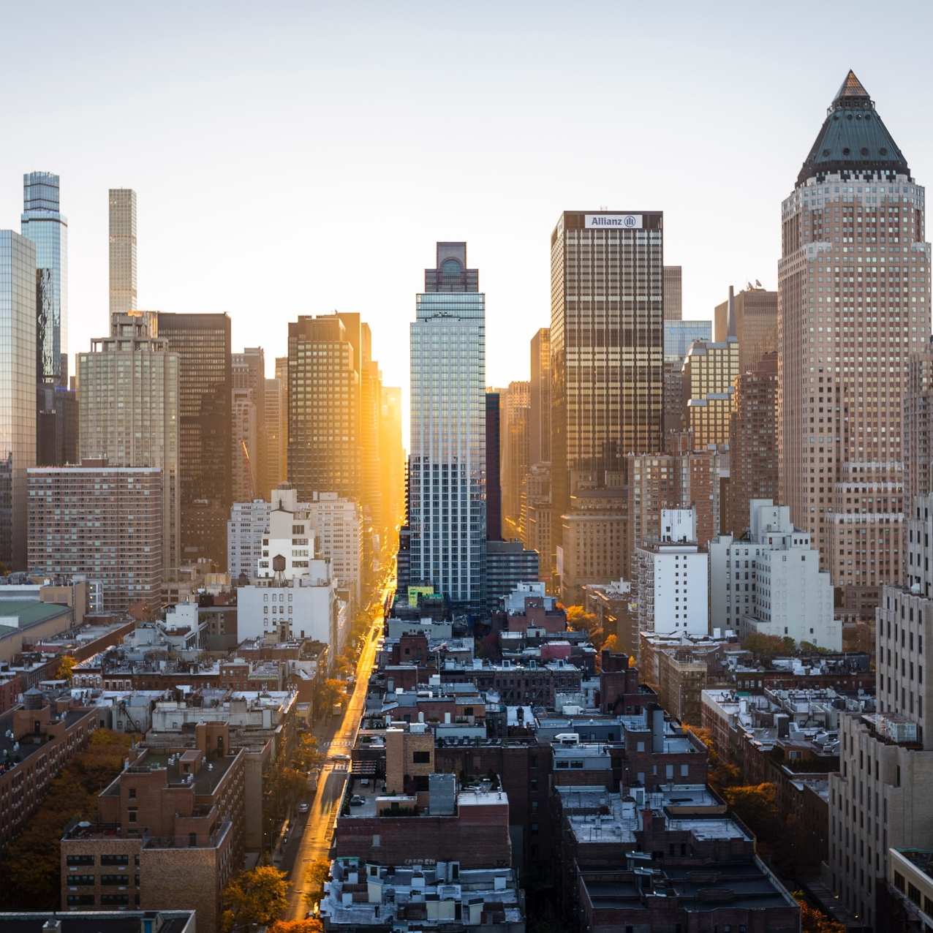
Business Hunting and Intelligent Advisor.
Investment intelligent advisor for investors in Toronto

Slide 2
Agenda
Introduction.
Data acquisition and cleansing.
Methodology.
Results and Discussions.
Conclusion.

Slide 3
Introduction
Investment in Canada is a very hot topic particularly in Toronto.
Some people find that it is a very tough job to collect a survey of all investments' types in Toronto, therefore I have created this intelligent advisor.
The purpose of this advisor is to dig into all areas of Toronto using FourSquare location and venues information to provide a very nice summary for the investors to help them hunt the most suitable investment to be constructed in order to gain the highest profit.
Audience of this advisor are the business owners who are looking for a great business and profitable investment in Canada and in particular in Toronto.
In the final report, the investor will be able to identify the lack of certain services across different locations, or even the quality of the provided services using the collected tips in order to provide unique or better services.

Slide 4

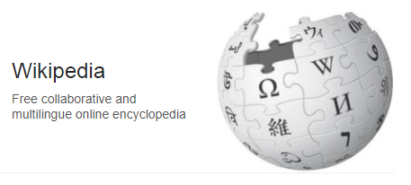
Data acquisition and cleansing.
In this section I will collect data from different sources about the Toronto area using the following sources:
1-Wikipedia.
2-Foursquare location data.
These sources contain data about the neighborhoods and venues in Toronto area. Finally i will be using the below steps to collect data from those sources.

Slide 5
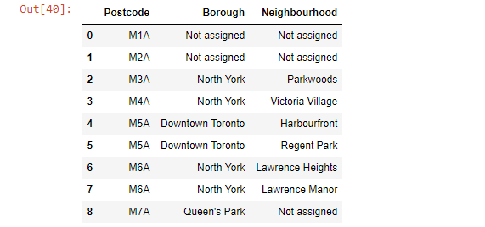
Extract data of Toronto neighborhoods from Wikipedia
But the returned records contain unprocessed or incomplete data, which needs data cleansing an preparation.
The following steps were taken to beautify the data returned.

Slide 6
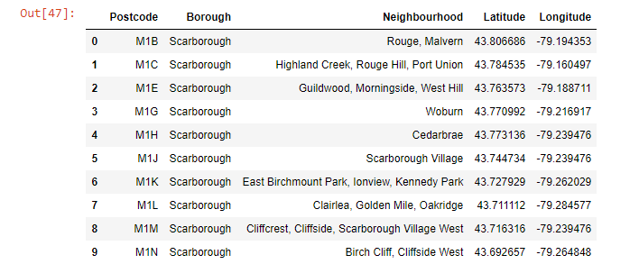
Join all data sources together to beautifying the collected data.

Slide 7
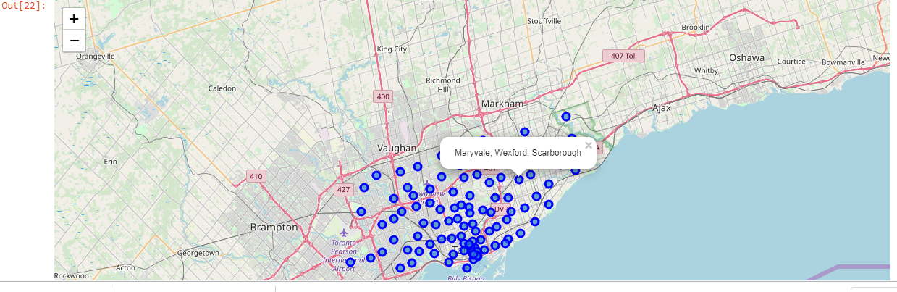
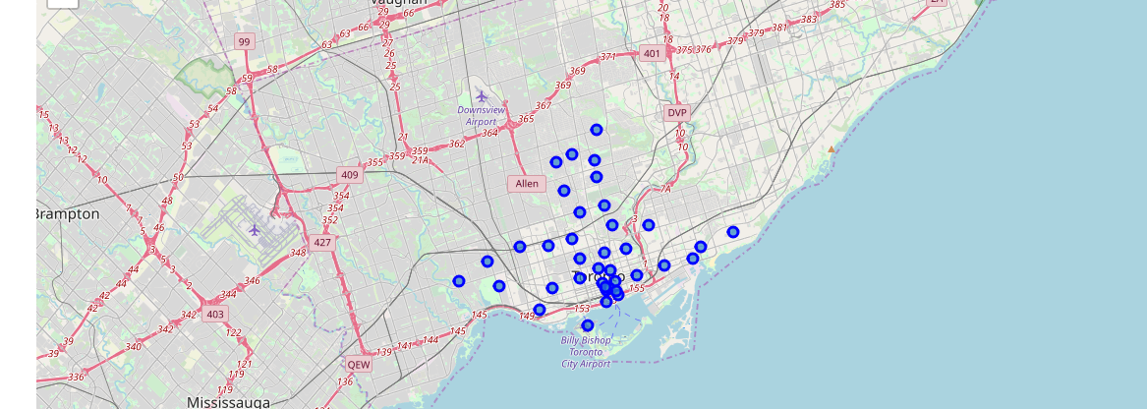
Create maps of the boroughs that contain the word Toronto

Slide 8
Methodology
In this project we will direct our efforts on detecting areas of Toronto that have any, particularly those sort of investments. We will limit our analysis to area around city center.
In first step we have collected the required data: location and type (category) of every investment within certain radius from Toronto center. We have also identified the famous venues (according to Foursquare categorization).
Second step in our analysis will be calculation and exploration of 'investment density' across different areas of Toronto - we will use maps to identify a few promising areas close to center with low number of certain investment in general and focus our attention on those areas.
In third and final step we will focus on most promising areas and within those create clusters of locations that meet some basic requirements established in discussion with stakeholders: we will take into consideration locations. Also we will present map of all such locations but also create clusters (using k-means clustering) of those locations to identify general zones / neighborhoods / addresses which should be a starting point for final 'street level' exploration and search for optimal venue location by stakeholders.

Slide 9
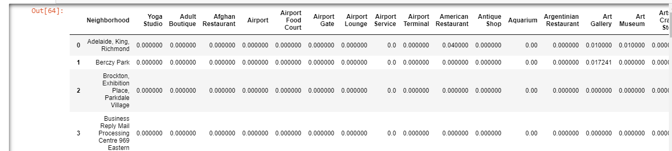
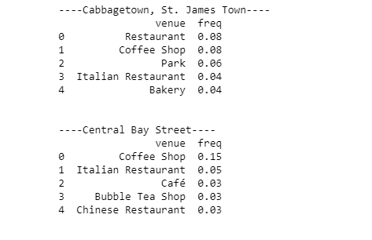
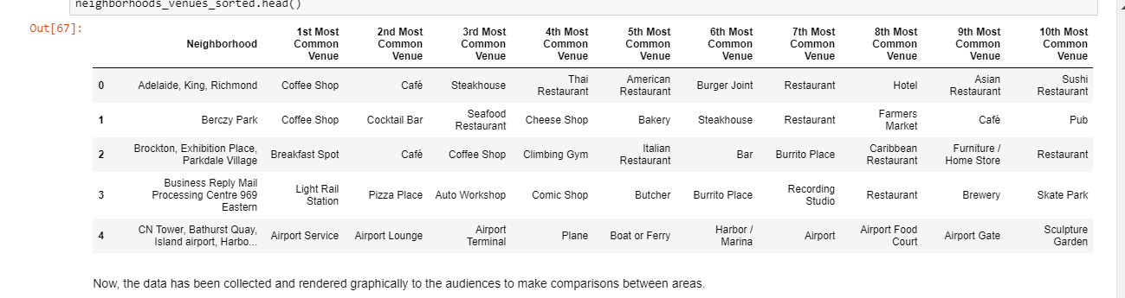
Analyze the neighborhoods
Let's print each neighborhood along with the top 5 most common venues

Slide 10
Results and Discussion
Our analysis shows that although there is a great number of investments in Toronto, there are pockets of low cloth stores density fairly close to city center. Highest concentration of different investments types were detected north and west from Toronto, so we focused our attention to areas south, south-east and east, corresponding to Cabbage town, St. James Town which offer a combination of popularity among tourists, closeness to city center, strong socio-economic dynamics and a number of pockets of low clothes stores density.
After directing our attention to this more narrow area of interest (covering Cabbage town, St. James Town. We first created a dense grid of location candidates
Those location candidates were then clustered to create zones of interest which contain greatest number of location candidates. Addresses of centers of those zones were also generated using reverse geocoding to be used as markers/starting points for more detailed local analysis based on other factors.
Result of all this is containing largest number of potential new clothes stores locations based on number of and distance to existing venues - both stores in general and non-food investment particularly.
Purpose of this analysis was to enable the investors to choose the right type of investment across Toronto areas in order to get the highest profits.

Slide 11
Conclusion
Purpose of this analysis was to enable the investors to choose the right type of investment across Toronto areas in order to get the highest profits.
By calculating investments density distribution from Foursquare data we have first identified general boroughs that justify further analysis , and then generated extensive collection of locations which satisfy some basic requirements regarding existing nearby investments. Clustering of those locations was then performed in order to create major zones of interest (containing greatest number of potential locations) and addresses of those zone centers were created to be used as starting points for final exploration by stakeholders.
Final decision on optimal investment type location will be made by stakeholders based on specific characteristics of neighborhoods and locations in every recommended zone, taking into consideration additional factors like attractiveness of each location (proximity to park or water), levels of noise / proximity to major roads, real estate availability, prices, social and economic dynamics of every neighborhood etc.

Slide 12
Thank You

